Slide 1
Group 15 data collection attempts

Slide 2
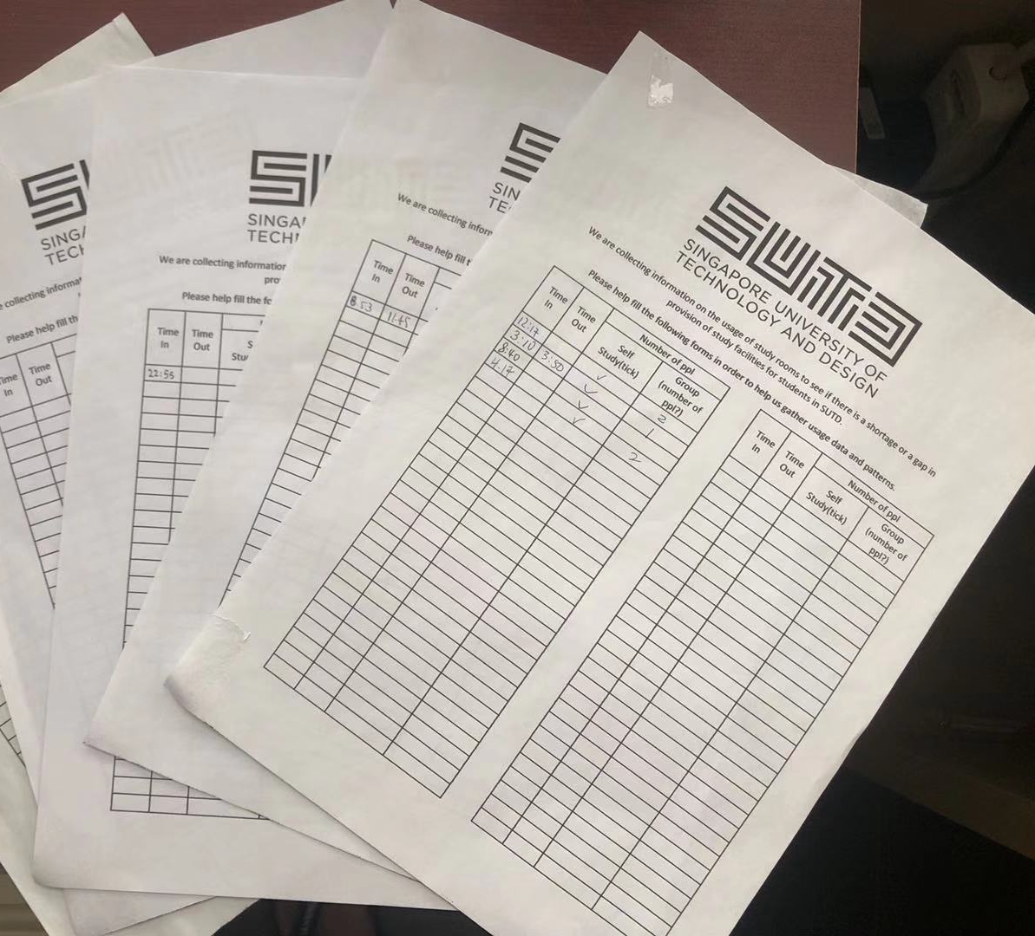
In order to get a more accurate statistic for the scenario of students utilizing study facilities. We designed the data collection survey sheets and pasted in over 10 different study areas in SUTD campus.
However, we did not get enough responses to make a robust conclude. Therefore, we used a reasonable interarrival time to simulate students coming to library to study

Slide 3
